Slide 1

power consumption power consumption Power Consumption
BY: Rachana Padaya

Slide 2
Problem Statement
The objective is to develop a machine learning model that can predict the power consumption (Zone 1 Power Consumption) of Wellington, New Zealand based on various environmental and meteorological factors.
Objective:
Create an accurate predictive model that can assist in managing energy resources efficiently and optimizing power consumption in that zone.

Slide 3
Data Overview
Dataset Size:
Rows: 52,584
Columns: 9
Independent Features: 'S_no', 'Temperature', 'Humidity', 'Wind_Speed’, 'gen_diffuse_flows', 'diffuse_flows', 'AQI(PM)', 'Cloudiness'
Target/Dependent Feature: Power_Consumption(A)
Categorical Features: 3
Numerical Features: 6
Missing Values: Data have total of 1.45% missing data.
Duplicate Values: Dataset does not have any duplicate data.
Datatype: Out of all columns, Temperature and Humidity have mismatch datatypes.

Slide 4
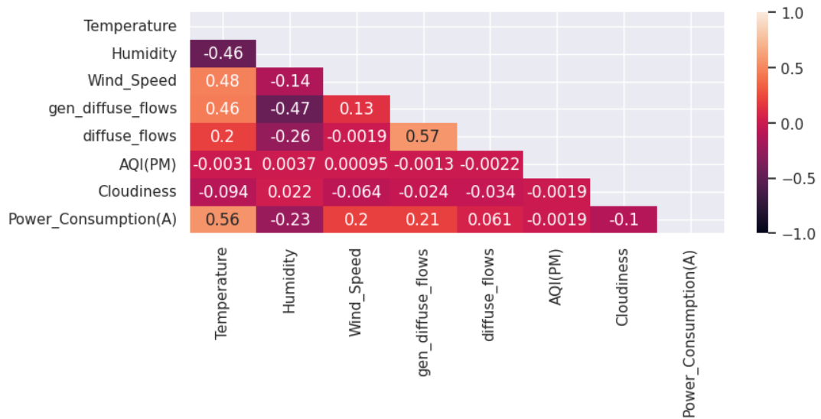
Data Preprocessing
Handling Missing Values: Dropped 440 records because of 1.45% missing data.
Outlier Treatment: Used IQR method for outlier treatment on Temperature, Humidity, gen_diffuse_flows and diffuse_flows features.
Encoding of Categorical data: No encoding needed.
Data Cleaning: Dropped the S_no and Cloudiness columns.

Slide 5
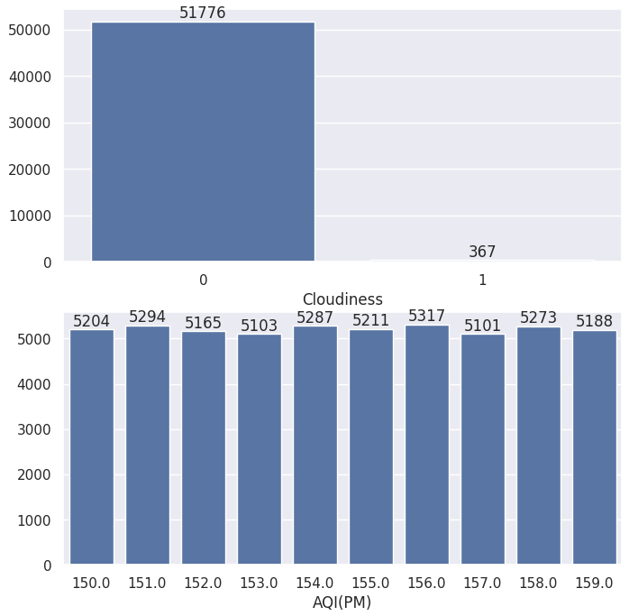
Categorical Features
Represents categories or labels that are discrete and distinct.
Nominal Data: Gender, Customer Type and Type of Travels are nominal data, it means we should not give order to segregate its classes.
Ordinal Data: Class column is ordinal data, it means it has some order to its classes.

Slide 6
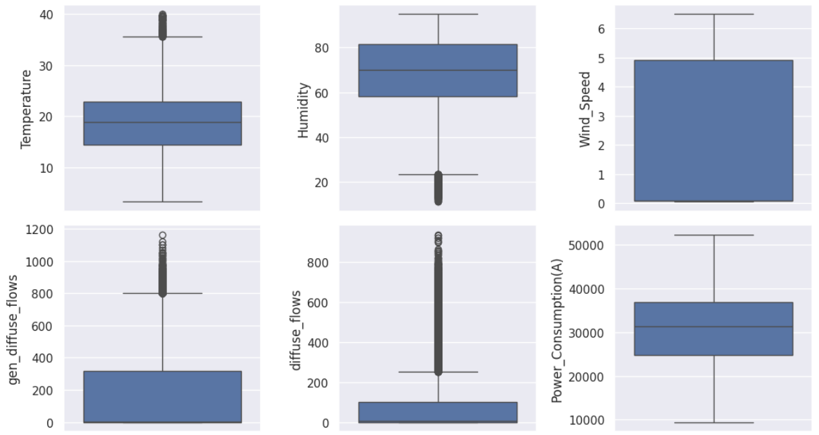
Numerical Features
Represents measurable quantities with a logical order.
Continuous: Can take any value within a range (e.g., height, weight, temperature).
Discrete: Countable values (e.g., number of students, page visits).

Slide 7
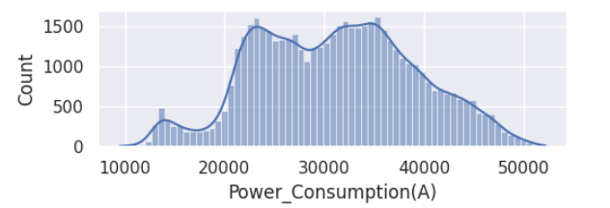
Target Variable analysis
Power_Consumpion(A) is our Target Column.
Target column does not have any outliers.
Target Column datas are normally distributed.

Slide 8
Model Selection
Tree-Based Models
Linear Models
Other Models
Tree-Based Models
Decision Tree Regressor
Random Forest Regressor (Ensemble)
XGBoost Regressor
Voting Regressor (Ensemble)
OLS (Least Ordinary Squared)
Ridge (L2 Penalty)
Lasso (L1 Penalty)
Linear Regressor
SVR (Support Vector Regressor)
Polynomial Regressor
ANN (Artificial Neural Network)

Slide 9
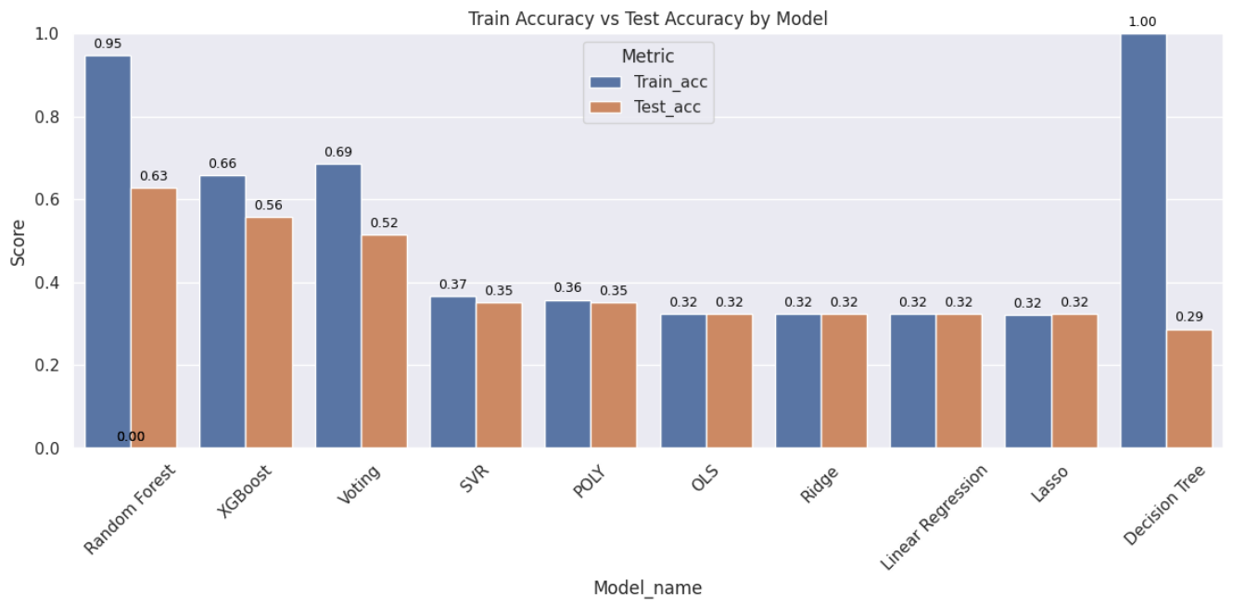
Model Performance Comparison

Slide 10
Conclusion
XGBoost outperformed other models, showing just a 10% difference between training accuracy (66%) and testing accuracy (56%), while other models exhibited either high variance or high bias.
Model generalized well, with good train-test accuracy.
The ANN model achieved similar training and testing accuracies (58.35% and 58.78% respectively)

Slide 11
THANK YOU
Would love to answer any questions you might have?

